Slide 1
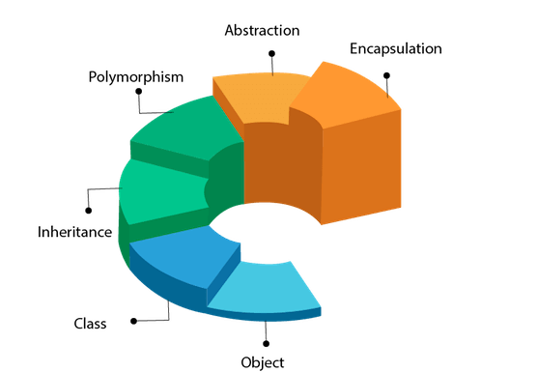
Object Oriented Programming
By Jesus Javier Ponce

Slide 2

The Car Manufacturer
You have recently been hired as a car manufacturer are tasked with 3 objectives.
Understand a customers requirement
Meet the customers need
Do it efficiently.

Slide 3
The Blueprints
Vehicle
Truck
SUV
Sport

Slide 4



The Customers
John - The construction worker
Susan - The Soccer Mom
Dan - The racer

Slide 5
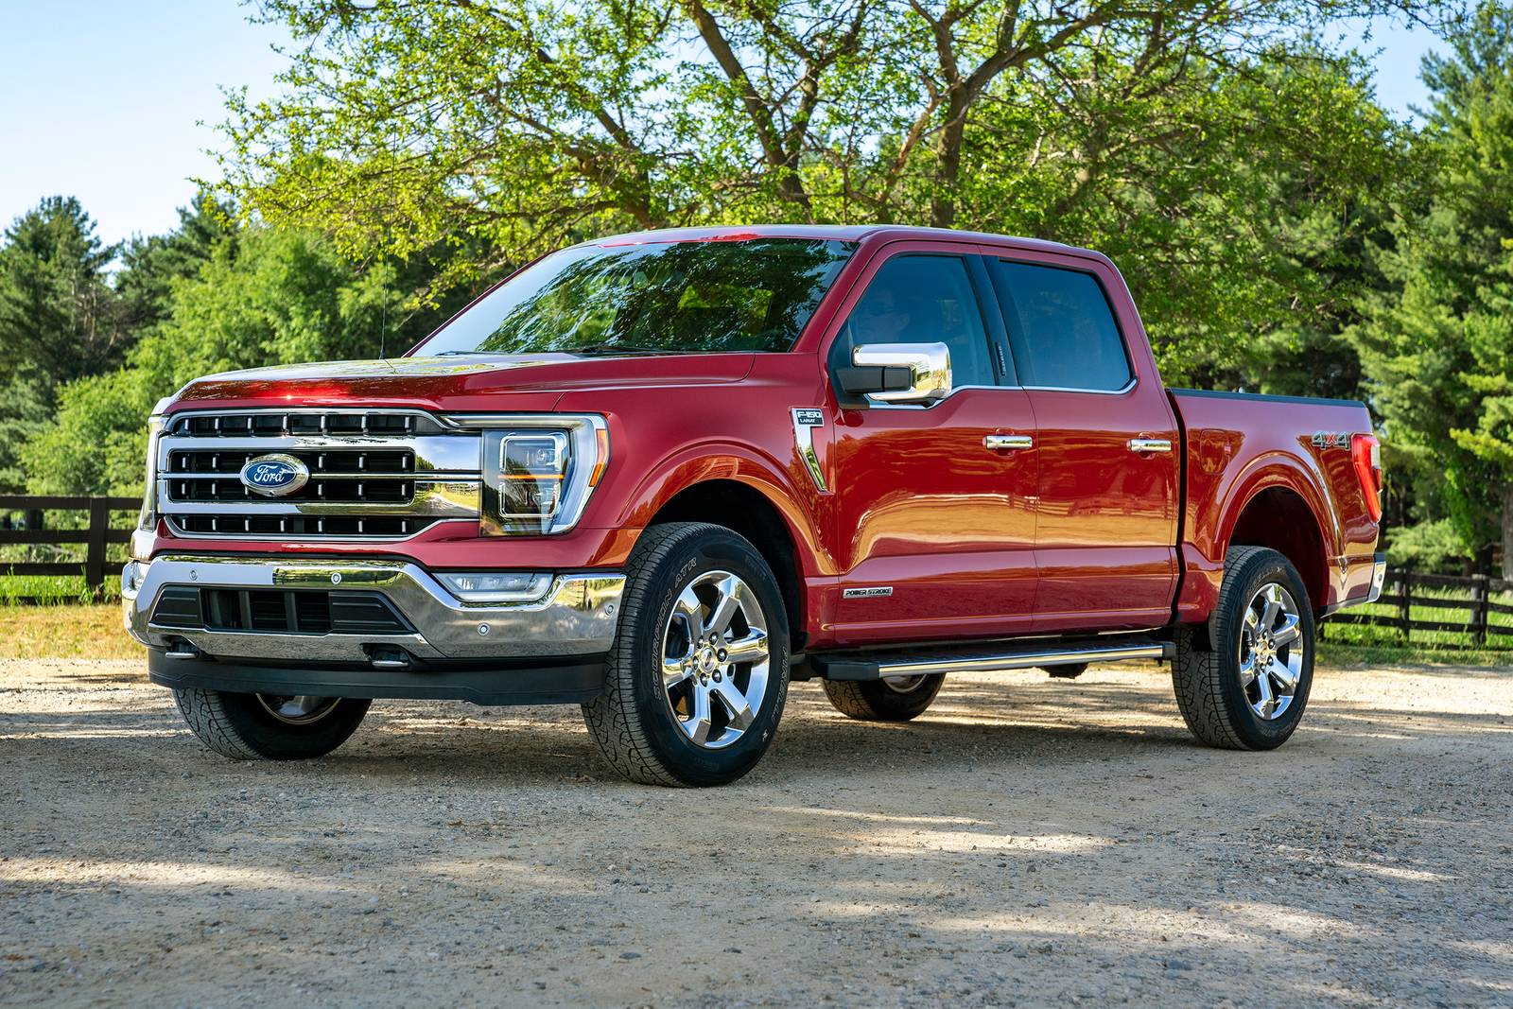
The Instances - Ford F-150
John - The construction worker

Slide 6
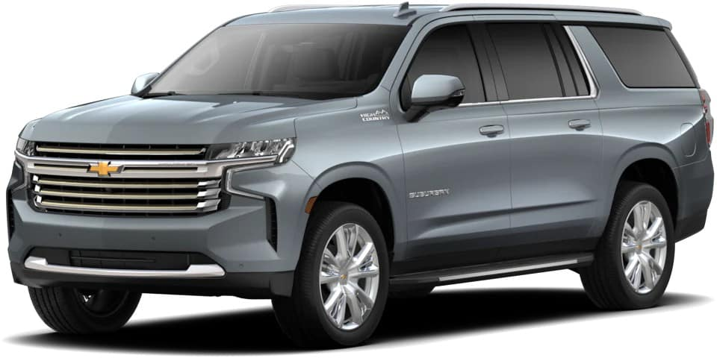
The Instances - Chevy Suburban
Susan - The Soccer Mom

Slide 7

The Instances - Porsche 911 Turbo S
Dan - The racer

Slide 8
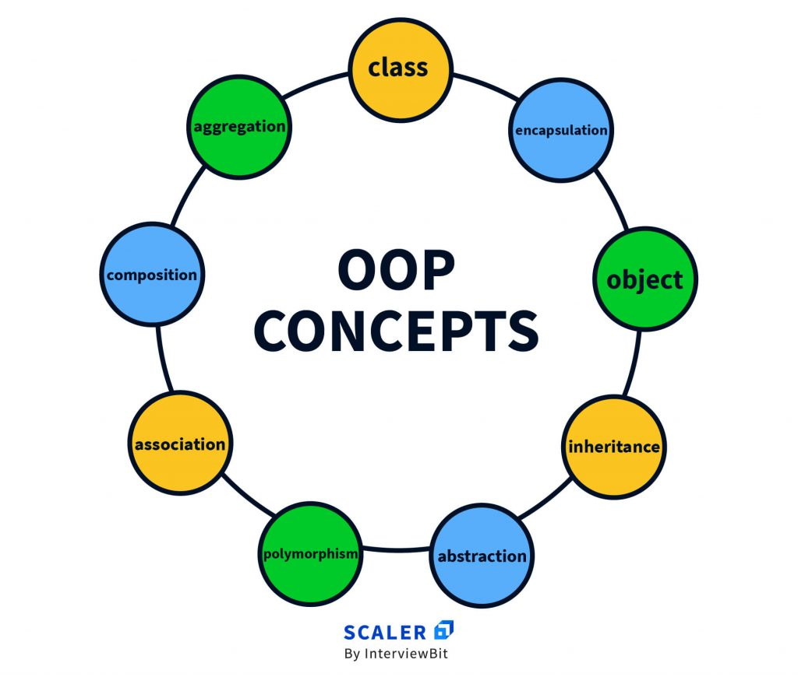
Programming Application
Now we apply the scenario to Object Oriented programming:
Classes
Objects/Instances
Inheritance

Slide 9

Classes are a Blueprint
Classes contain predefined:
Variables
Functions
Methods
Classes are used when you need to create a lot of similar items.

Slide 10


Objects/Instances
Objects/Instances are the result containing the specific information.
Example:
Ford F-150
Chevy Suburban
Porsche 911
Class:
Object/Instance:

Slide 11

Inheritance
Inheritance is the act of traits being passed between classes:
Every single car will contain:
4 Wheels
Doors
Windows
Engine
Then every car will have individual traits in addition to.

Slide 12
Inheritance example
Attributes
Cars
Functions
-4 Wheels
-Windows
-Can Drive
Truck
SUV
Sport
-Truck Bed
-4WD
-4 Wheels
-Windows
-Can Drive
-9 Seats
-Automatic doors
-4 Wheels
-Windows
-Can Drive
-2 Doors
-Sports Mode
-4 Wheels
-Windows
-Can Drive

Slide 13
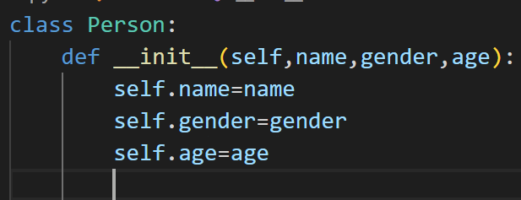
Syntax
Creating a Class/blue print and setting the variables:

Slide 14
Syntax
Creating a Class and defining a blueprint:
class Person: #create class
def __init__(self, job, name, age): #initialize class function with 3 variables
self.job = job
self.name = name
self.age = int(age)

Slide 15
Syntax
Creating an object:
Bob is the variable holding 3 places in person class
Bob = Person("contracter", "Bob", "40")
Creating a Class and defining a blueprint:
class Person: #create class
def __init__(self, job, name, age): #initialize class function with 3 variables
self.job = job
self.name = name
self.age = int(age)

Slide 16
Syntax
Creating an object:
Bob is the variable holding 3 places in person class
Bob = Person("contracter", "Bob", "40")
Creating a Class and defining a blueprint:
class Person: #create class
def __init__(self, job, name, age): #initialize class function with 3 variables
self.job = job
self.name = name
self.age = int(age)

Slide 17
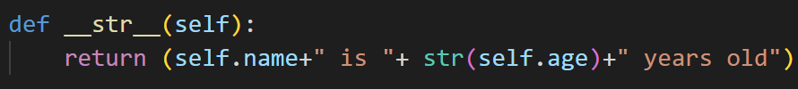
Syntax
Examples of Defining a print statement:
print("miles car can run " + str(Corolla.getmilage(10)))

Slide 18
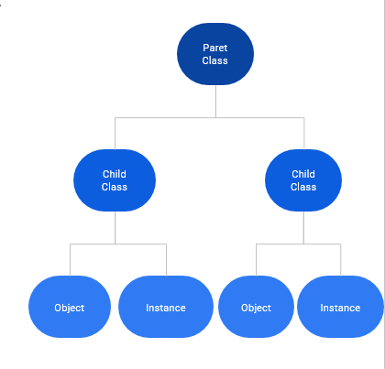
Syntax
Defining a child and parent classes:

Slide 19
Syntax
Creating a Parent an Child functions:
Defining a child class:
class Minivan(Vehicle): #uses vehicle parent class
def __init__(self, name, mpg, drive, engine, seats):
super().__init__(name, mpg, drive, engine)
self.seats = seats
Parent Class:class Vehicle:
def __init__(self, name, mpg, drive, engine):
self.name = name
self.mpg = int(mpg)
self.drive = drive
self.engine = engine

Slide 20


Syntax
Creating a Class:
Defining a print statement:
Without
With
Input:
Input:
Instantiating a Class:
Output:
Output:

Slide 21
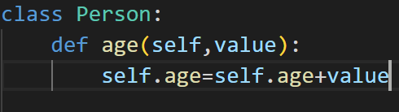
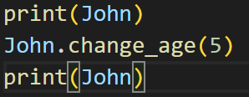
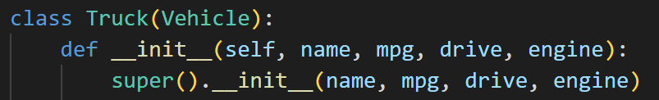

Syntax
Creating a function:
Defining a child and parent classes:
Parent Class:
Paret Class
Calling the function:
Child Class
Child Class
Child Class:
Object
Instance
Object
Instance
Output:

Slide 22

Good Luck

